Slide 1
Amazon Comprehend
Machine Learning

Slide 2
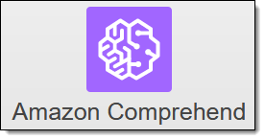
A machine learning driven service that allows you to discover insights and relationships in text

Slide 3
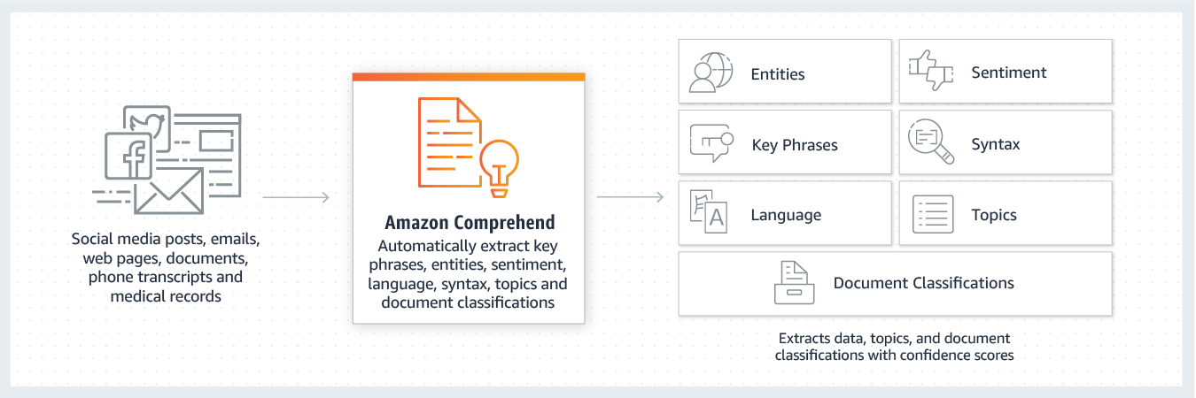
Powered by natural language processing (NLP)

Slide 4
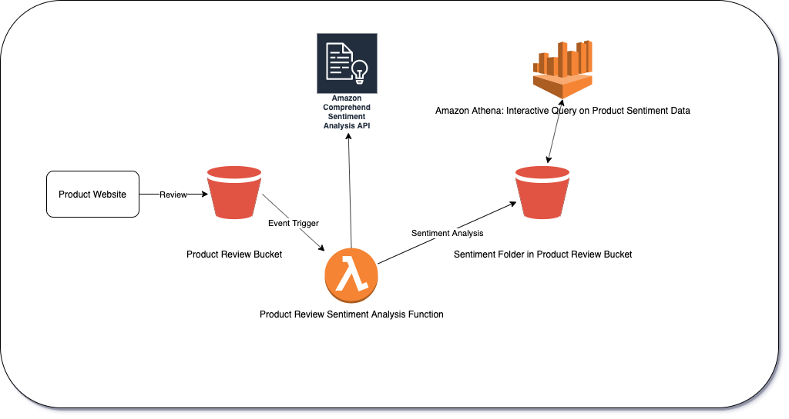
Gain insights from your text for use cases such as product reviews

Slide 5
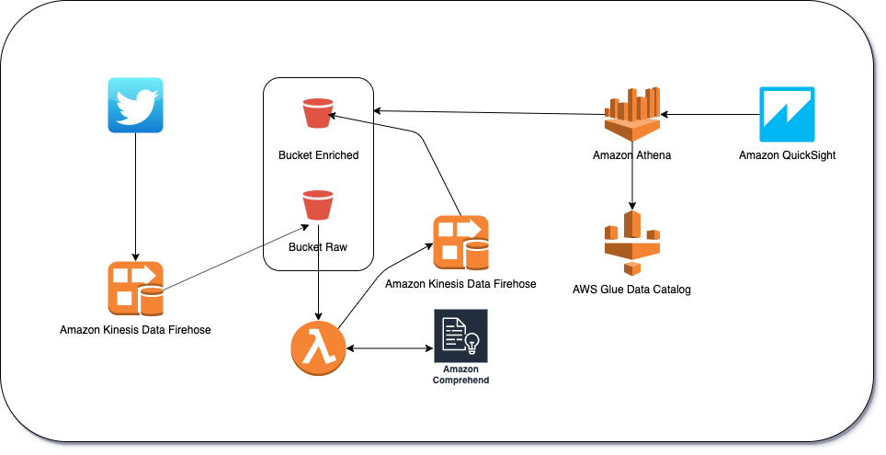
Gain insights from your text for use cases such as social media feeds

Slide 6
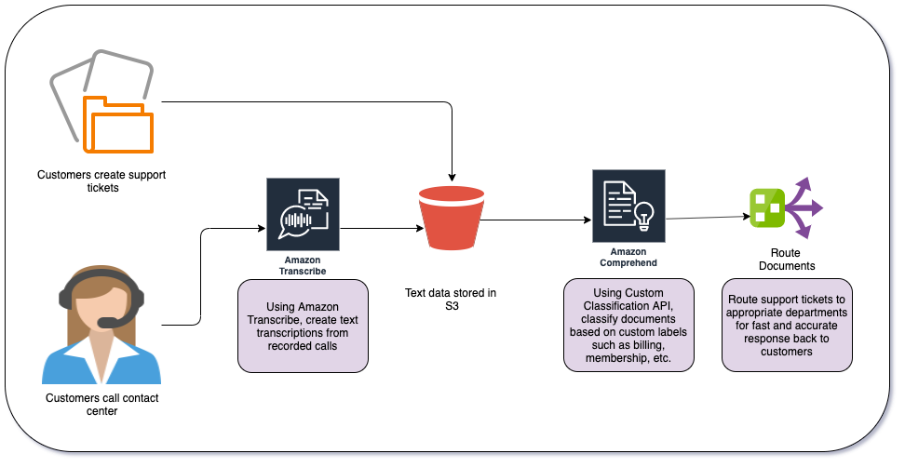
Gain insights from your text for use cases such as customer support incidents

Slide 7
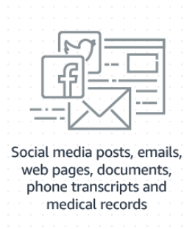
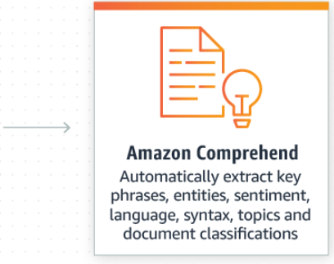
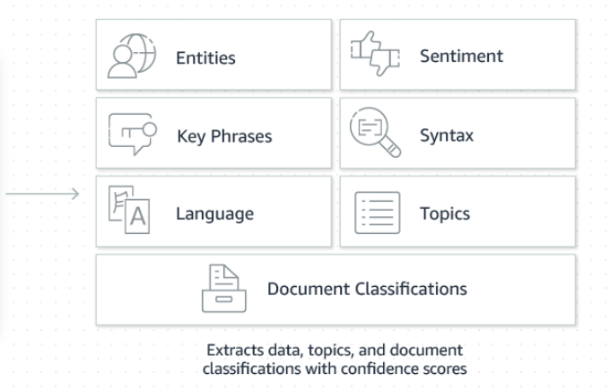
Amazon Comprehend - How It Works

Slide 8
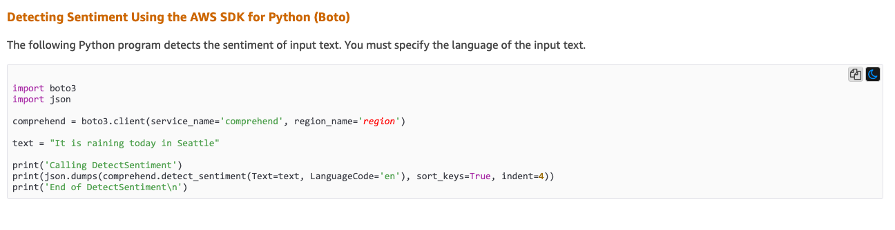
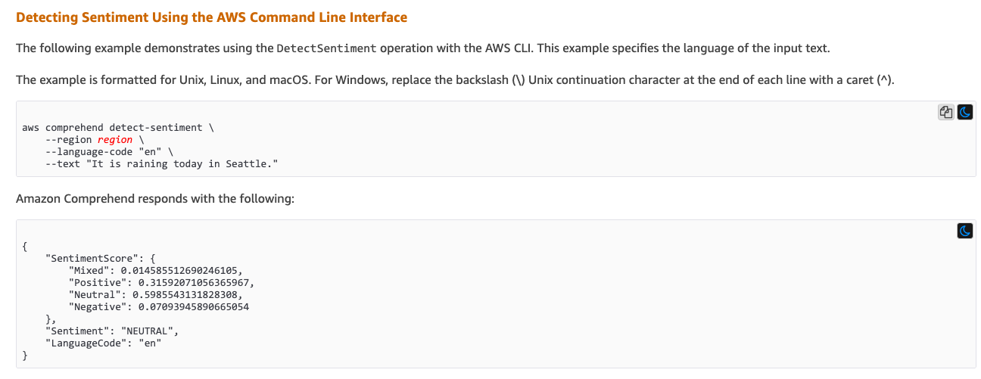
Demo of Comprehend API and CLI

